Slide 1
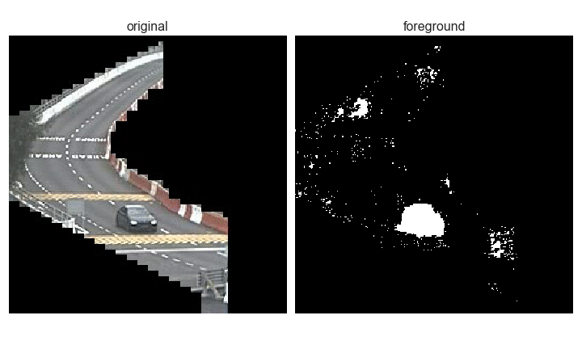
Traffic Image Analysis
Extracting traffic volume from traffic camera images

Slide 2
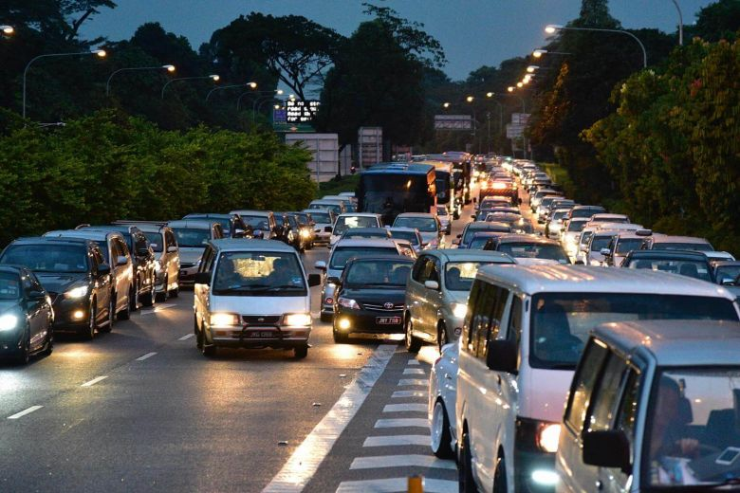
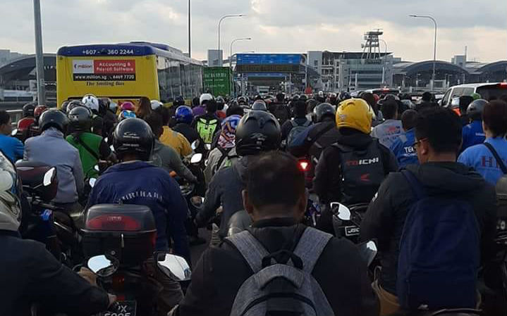
Problem Statement
Jams at the Woodlands and Tuas checkpoints are a frequent occurrence
Picking the wrong time or checkpoint to travel can mean hours wasted in traffic
Having an understanding of existing traffic conditions at the checkpoints would allow Singaporean commuters to make better decisions about whether or not to make the journey across at a given time.
Images:
https://www.straitstimes.com/singapore/travellers-endure-long-waits-at-tuas-and-woodlands-checkpoints-over-the-weekend
https://coconuts.co/singapore/news/tuas-checkpoint-ica-traffic-jam-motorists-several-hours-johor/

Slide 3
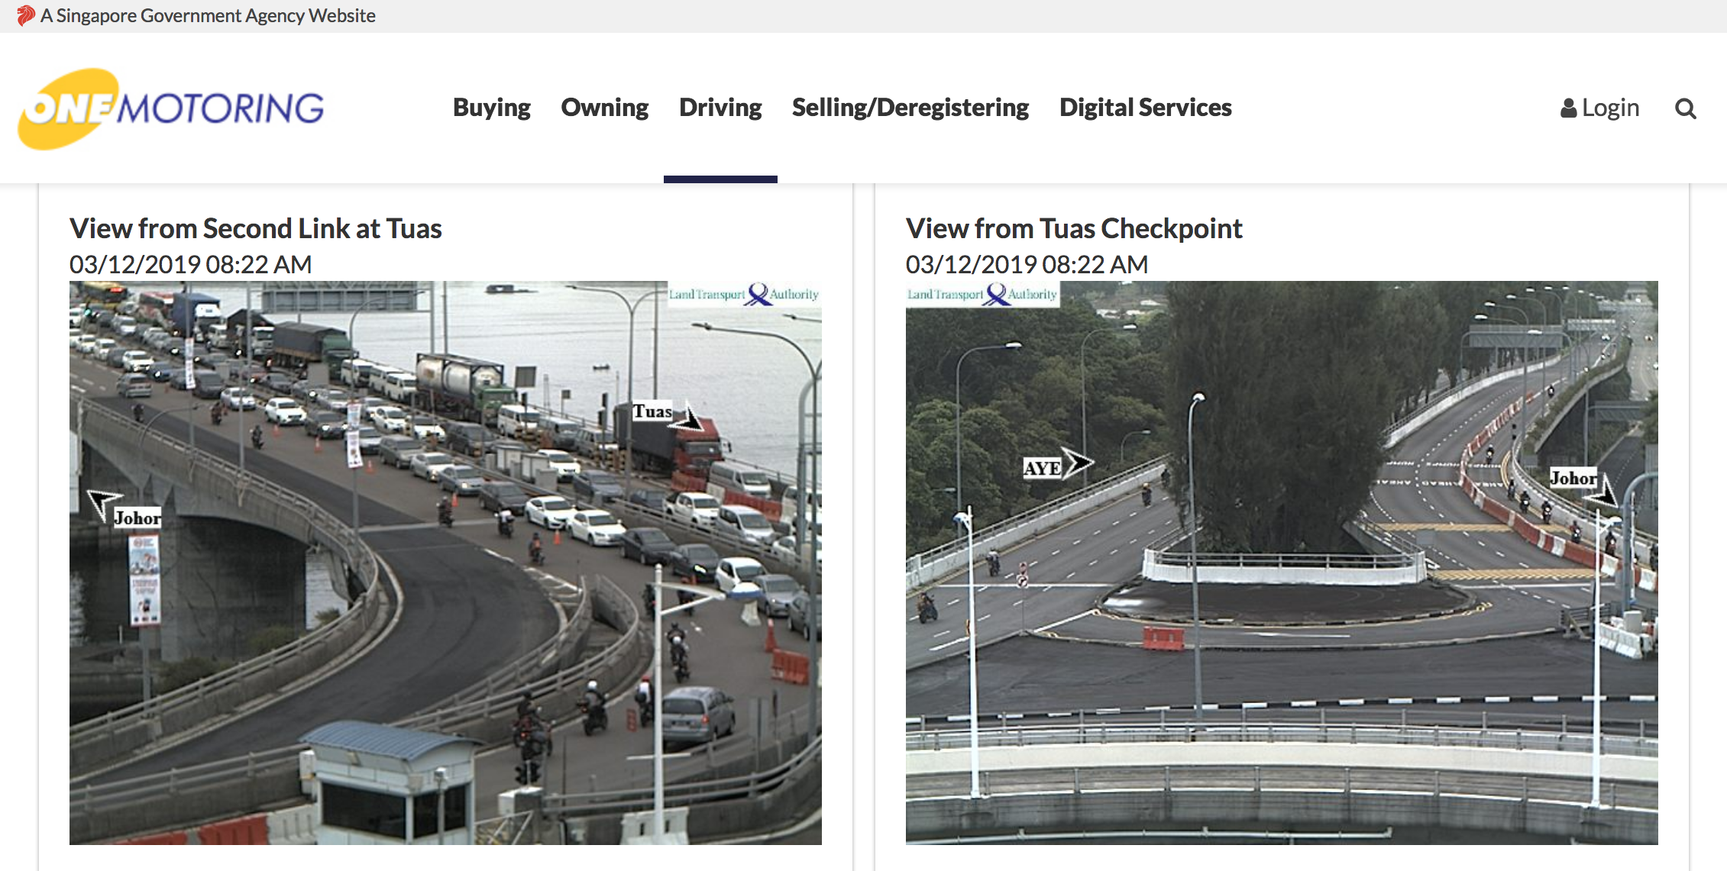
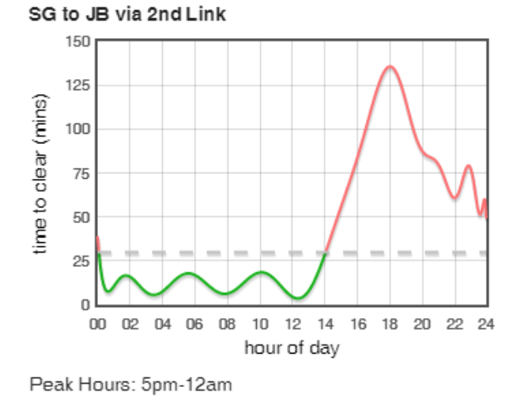
Currently available resources
Websites that display static images from the same traffic cameras API offered by LTA
No information about trend
"Beat the Jam" app uses Google Maps API
Depends on crowd-sourced data; not always accurate
Notes:
- Static images: data only in the present. People would have to guess how many cars were present before they visited the page, and how long the current condition is expected to last

Slide 4
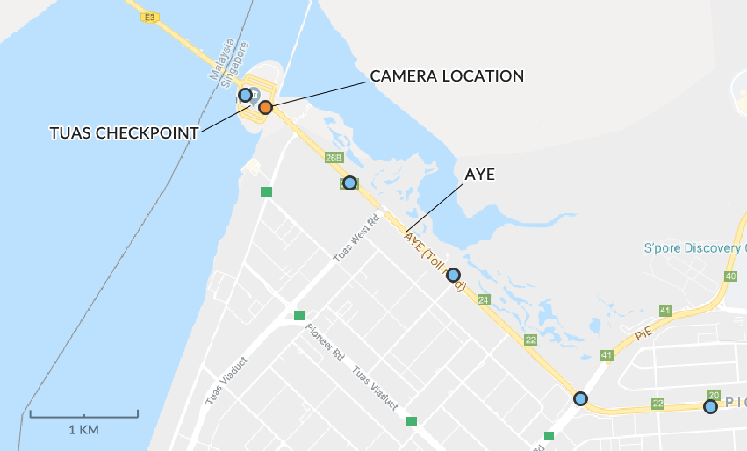
Data
LTA’s traffic cameras API
~1 image per minute

Slide 5
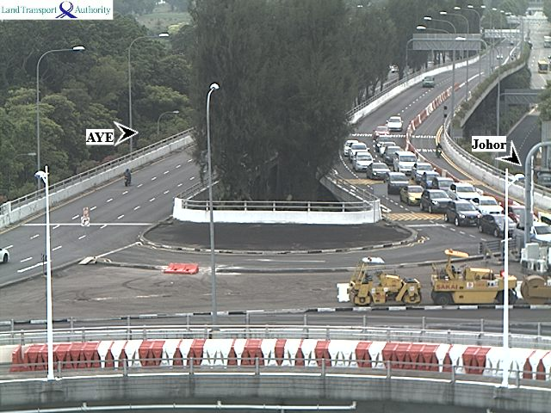
Image limitations
Low resolutions
(640 x 480)
Occlusion
Notes:
As can be seen below, the raw images have several limitations. Firstly, their resolutions are very low (480 px by 640 px). Secondly, the camera is angled such that cars further from the camera are occluded by cars closer to the camera.
This implicated the modelling approach, as it meant that counting cars by object detection was not possible. To train the model to predict the number of cars in each frame, I instead used a background subtraction algorithm (as explained below), together with manually labelled images.

Slide 6
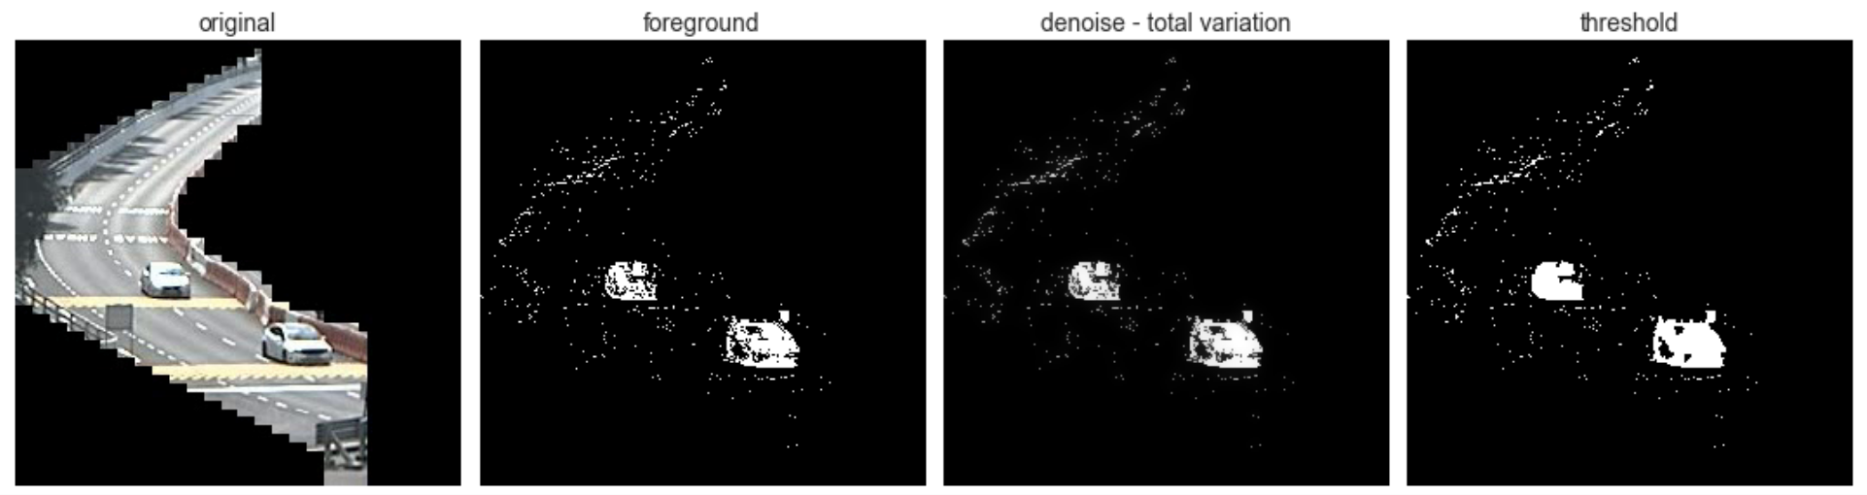
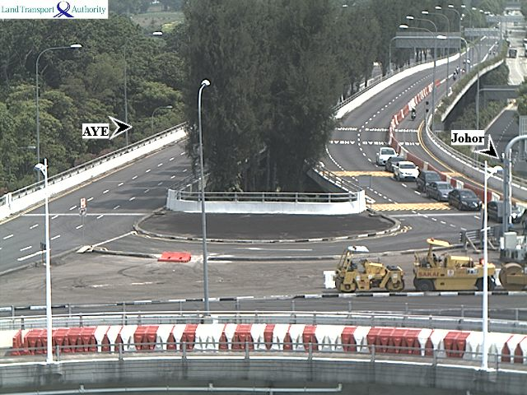
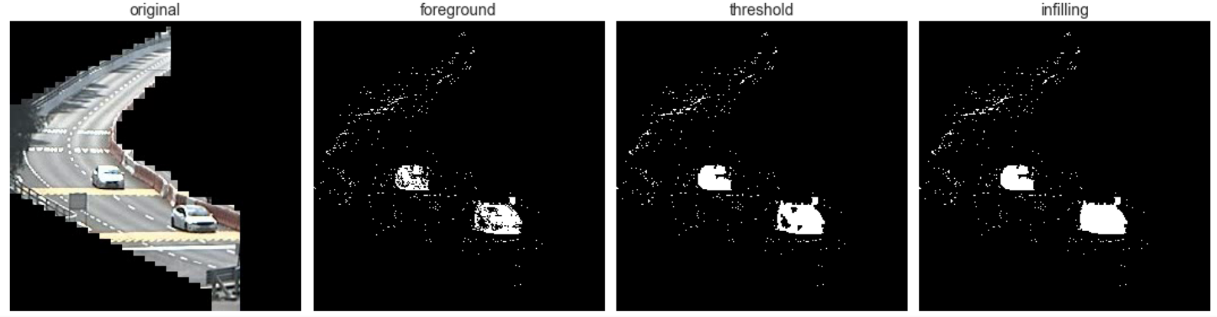
Preprocessing
Original
Cropped
Background subtraction
Model input
Remove noise
Threshold
Infilling
Notes:
The original data from the cameras look like this

Slide 7
“How congested?”
“How many cars?”
Classification (Machine learning)
>
Classification (Deep learning)
>
Regression (Deep learning)
>
Regression (Machine learning)
Model | Validation accuracy
Logistic regression | 0.90
KNN | 0.93
Decision tree | 0.91
Model | Validation accuracy
9-layer CNN | 0.98
Model | Validation MAE
11-layer CNN | 3.89
12-layer Convolutional LSTM | 3.98
11-layer ConvLSTM | 5.85
Model | Validation MAE
Linear regression | 4.58
Decision tree | 5.58
XGBoost* | 4.42
*production model

Slide 8
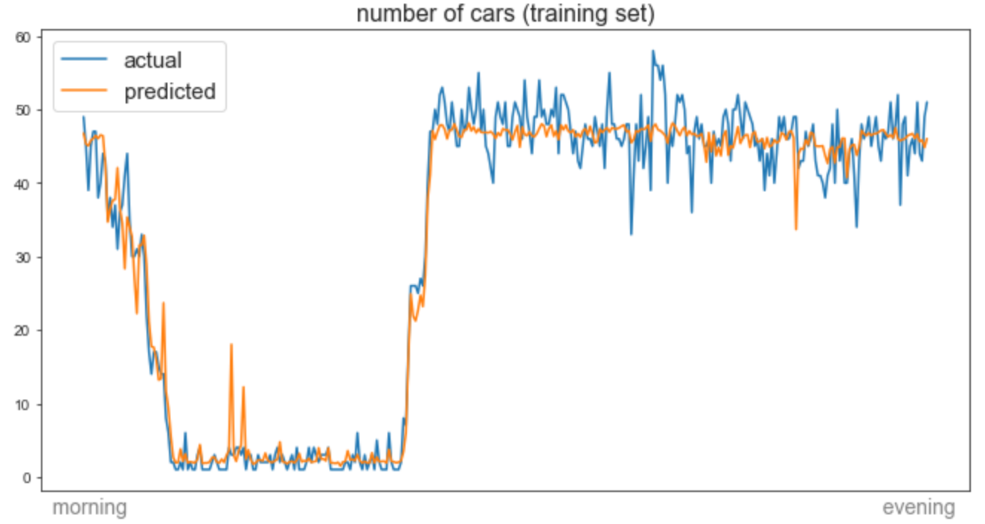
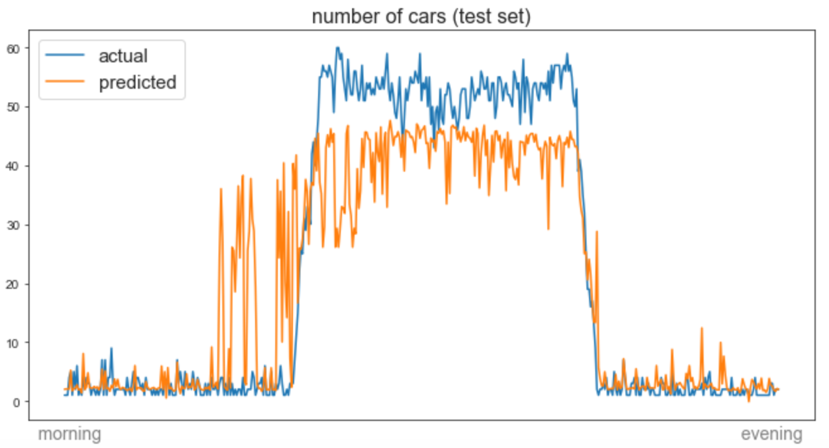
Modeling Results
MAE = 2.5
MAE = 6.6
MORNING → EVENING
Notes:
Off by an average of 4 cars per frame

Slide 9
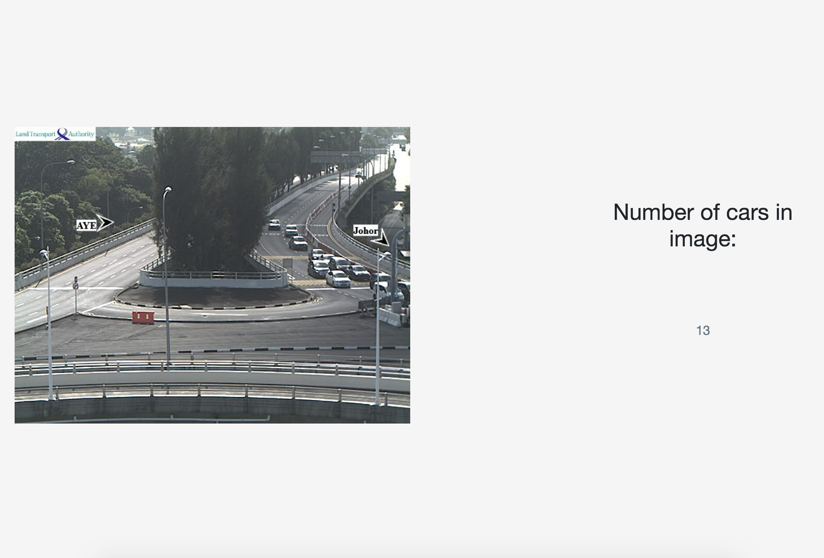
Deployment
UI
LTA API
1 minute
intervals
Scraping app
Web app
Heroku PostgreSQL server
Notes:
Off by an average of 4 cars per frame

Slide 10
Recommendations
Notes:
Off by an average of 4 cars per frame

Slide 11

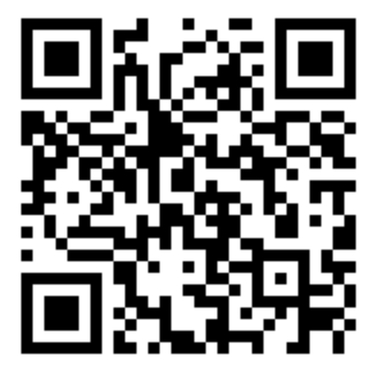
Thank you -
LinkedIn
Instructors and friends of DSI11 for the past 12 weeks!
Social media??

Slide 12
Extra slides

Slide 13
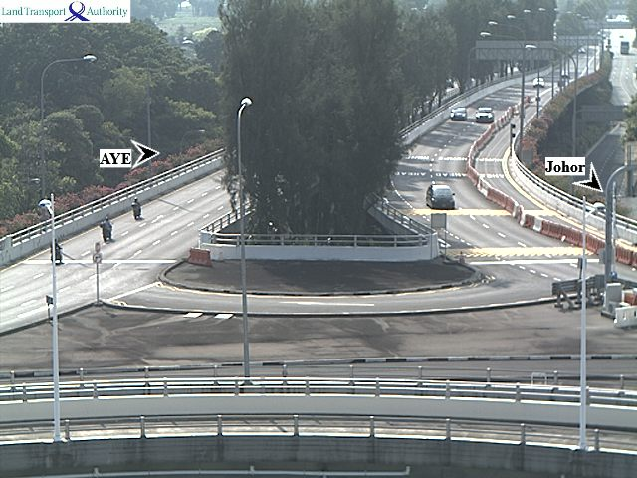
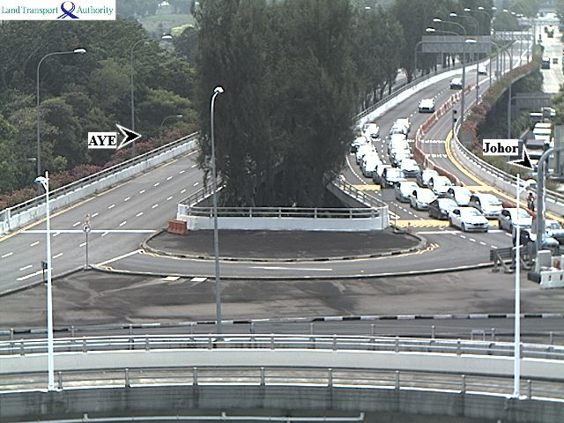
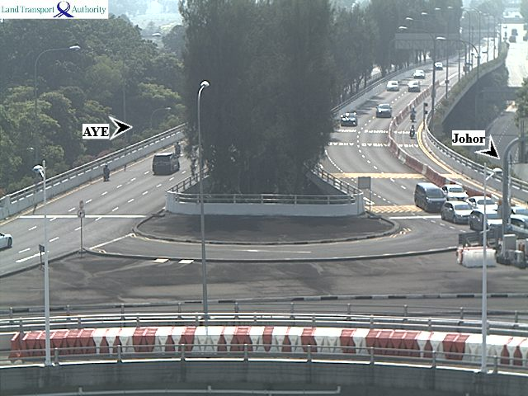
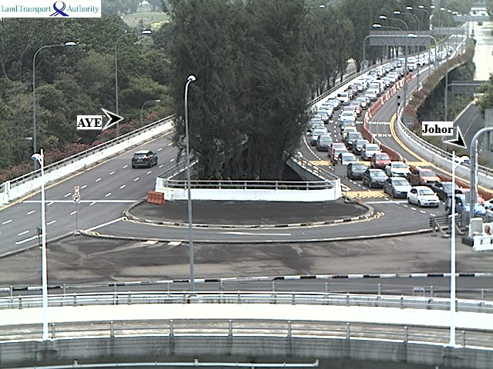
Step 2: regression
How many cars?
Notes:
Expand into a regression problem: predicting number of cars in an image.
To do this I needed labelled images with the number of cars.

Slide 14
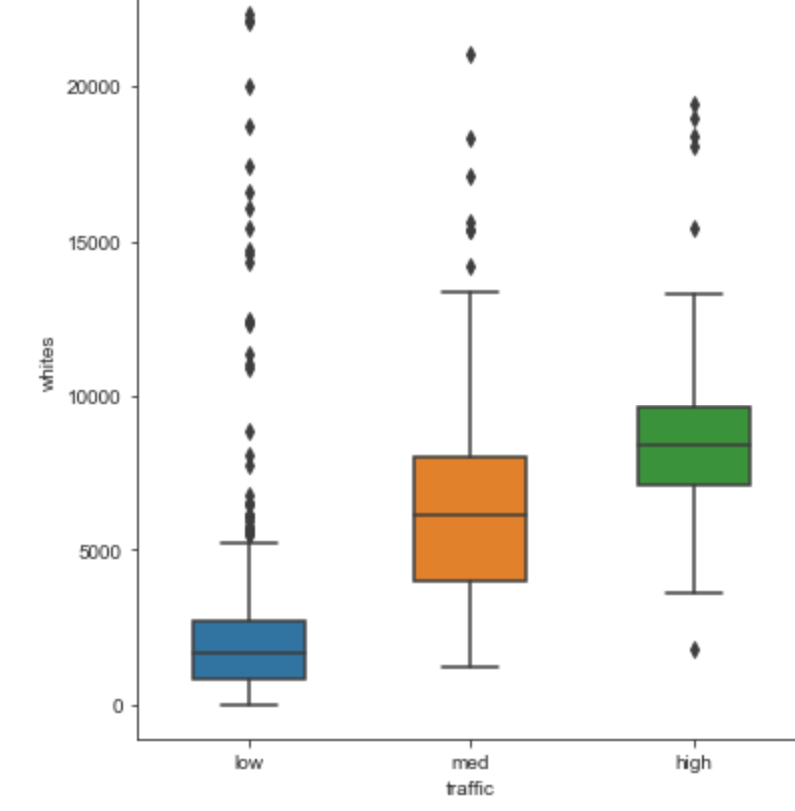
EDA
White pixels
low medium high
Notes:
To decide on the modelling approach I looked at whether the white pixels (foreground) is different for each category

Slide 15
Model Architecture Convolutional LSTM
time_distributed_1: TimeDistributed(Conv2D)
time_distributed_2: TimeDistributed(MaxPooling2D)
time_distributed_3: TimeDistributed(Conv2D)
time_distributed_4: TimeDistributed(MaxPooling2D)
time_distributed_5: TimeDistributed(Conv2D)
time_distributed_6: TimeDistributed(MaxPooling2D)
time_distributed_7: TimeDistributed(Conv2D)
time_distributed_8: TimeDistributed(MaxPooling2D)
time_distributed_9: TimeDistributed(Flatten)
lstm_1: LSTM
dense_1: Dense
dense_2: Dense

Slide 16
Step 1: classification
Low traffic
Medium traffic
High traffic
Notes:
Low: no queues
Medium: queues starting to form, but not yet covering entire road
High: queue covers the whole road area in the camera

Slide 17
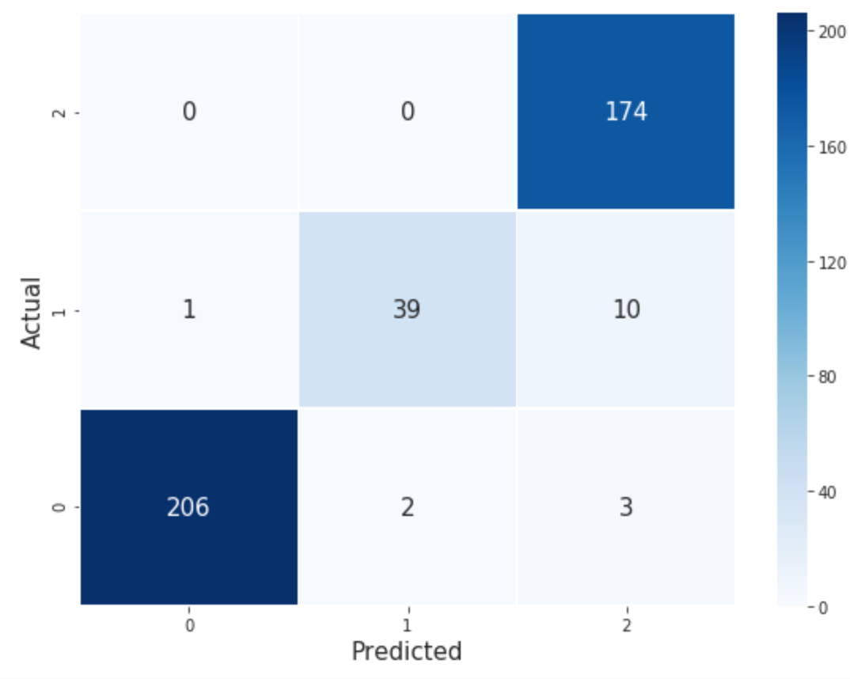
Accuracy: 96%
Notes:
Middle values are correct predictions

Slide 18
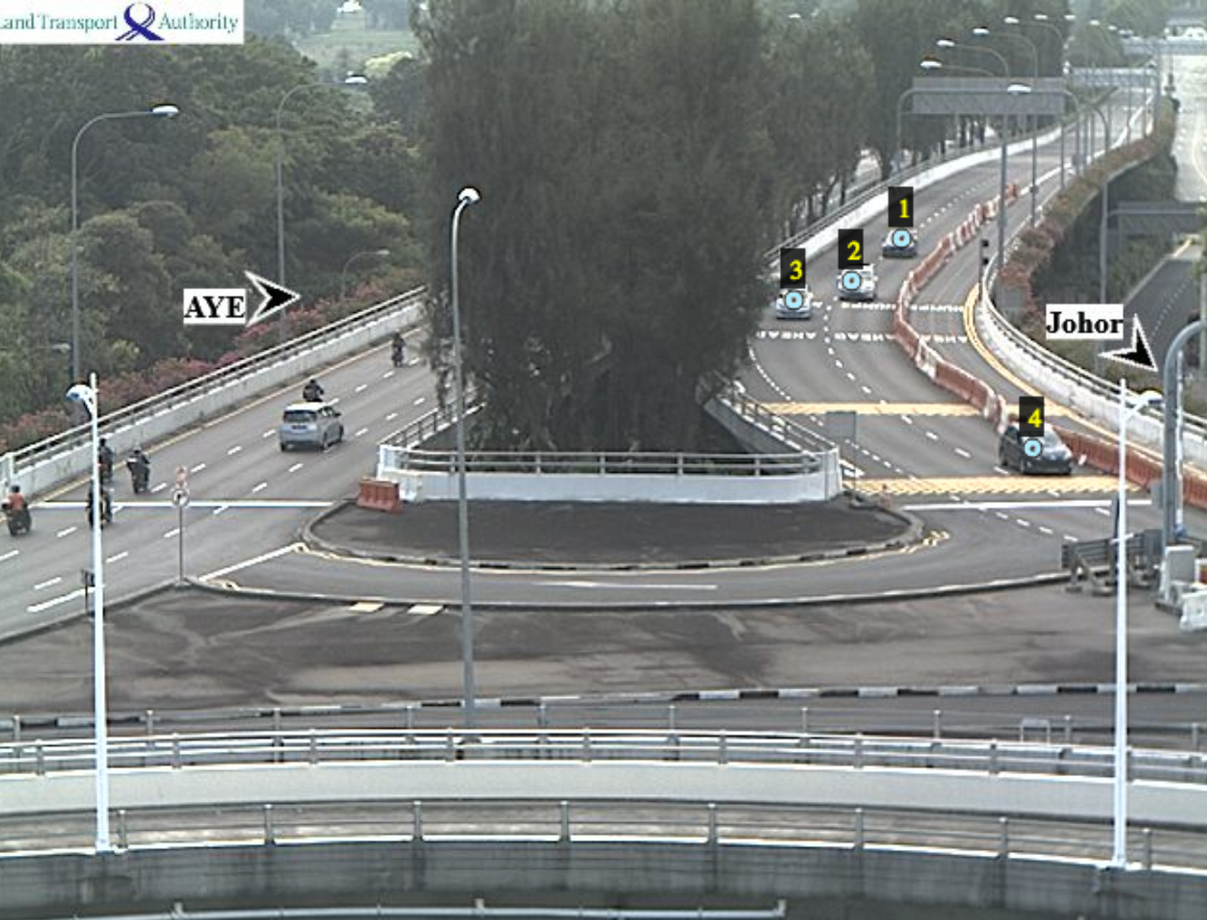
Labeling

Slide 19
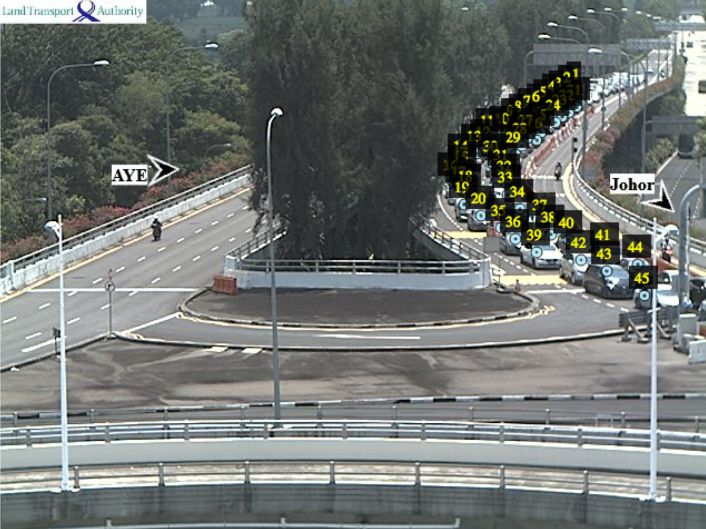
Labeling

